Slide 1



Slide 2
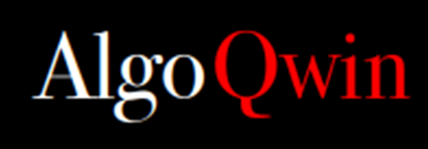
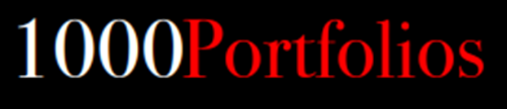




Slide 3
The information in this presentation is confidential and proprietary to Markov Markowitz – Coders in Finance and may not be disclosed without the permission of Markov Markowitz – Coders in Finance. Except for your obligation to protect confidential information, this presentation is subject to your Non-Disclosure Agreement with Markov Markowitz – Coders in Finance.
Markov Markowitz – Coders in Finance has no obligation to pursue any course of business outlined in this presentation or any related document, or to develop or release any functionality mentioned therein. This presentation, or any related document and Markov Markowitz – Coders in Finance's strategy and possible future developments, products and or platforms directions and functionality are all subject to change and may be changed by Markov Markowitz – Coders in Finance at any time for any reason without notice. The information in this presentation is not a commitment, promise or legal obligation to deliver any material, code or functionality. This presentation is provided without a warranty of any kind, either express or implied, including but not limited to, the implied warranties of merchantability, fitness for a particular purpose, or non-infringement. This presentation is for informational purposes and may not be incorporated into a contract. Markov Markowitz – Coders in Finance assumes no responsibility for errors or omissions in this presentation, except if such damages were caused by Markov Markowitz – Coders in Finance’s intentional or gross negligence. All forward-looking statements are subject to various risks and uncertainties that could cause actual results to differ materially from expectations. Readers are cautioned not to place undue reliance on these forward-looking statements, which speak only as of their dates, and they should not be relied upon in making purchasing decisions.

Slide 4

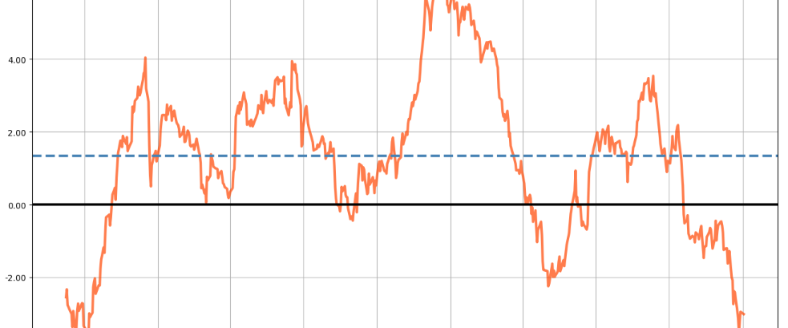
MHI based MDD optimized Portfolios
Key take aways:
Performance Parameters of a Portfolio
Exchange’s Market Health Index (MHI)
Market Health Index based Optimized Portfolios
Notes:
Konumuz biraz wealth management,
- bugüne kadar yaptığımız yatırımlar doğru muydu diye onun performansını ölçsek
- bir de işlem yapma potansiyelimiz olan piyasaların da durumunu ölçsek MHI
- geçmiş durumu ve bugünü dikkate alarak daha iyi bir yönetim yapabilir miyiz

Slide 5

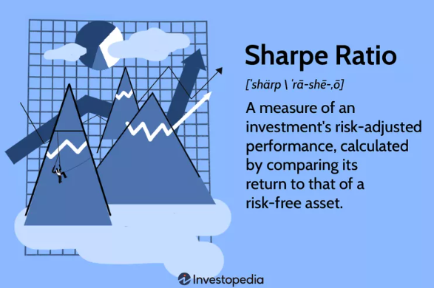
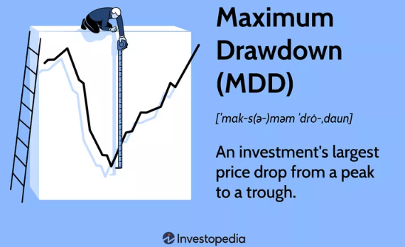
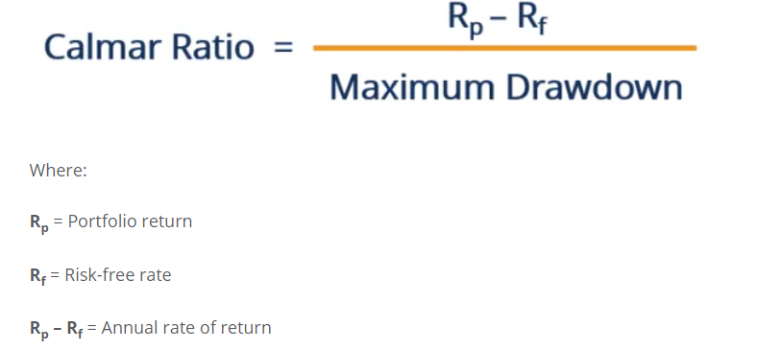
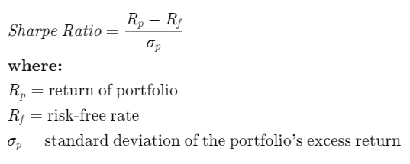
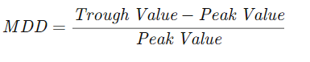
Some portfolio performance parameters
To be maximized:
To be minimized:
To be maximized:

Slide 6
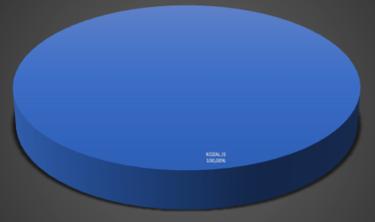
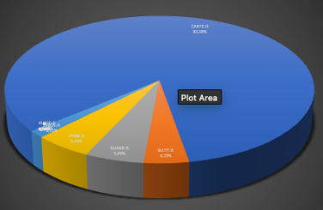
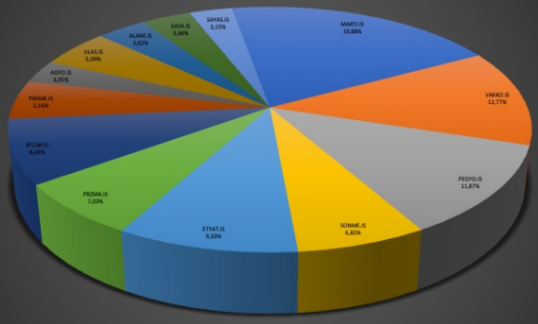
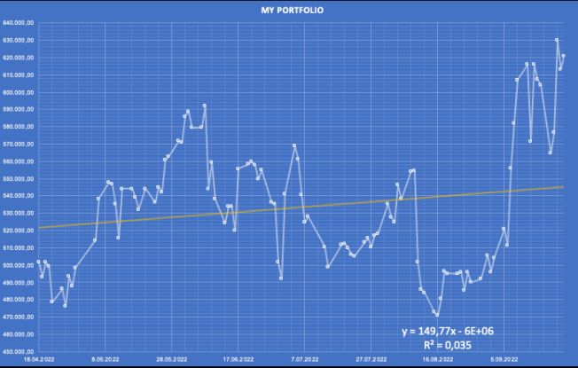
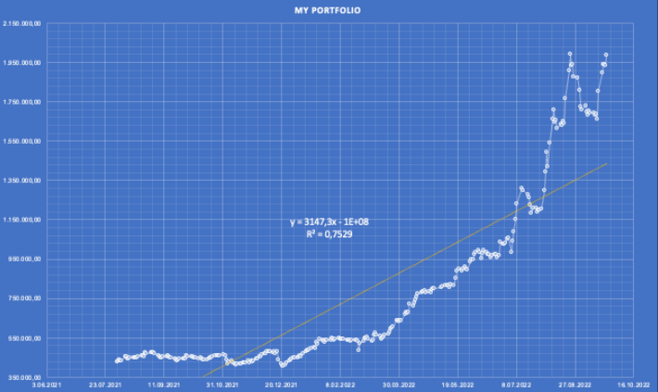
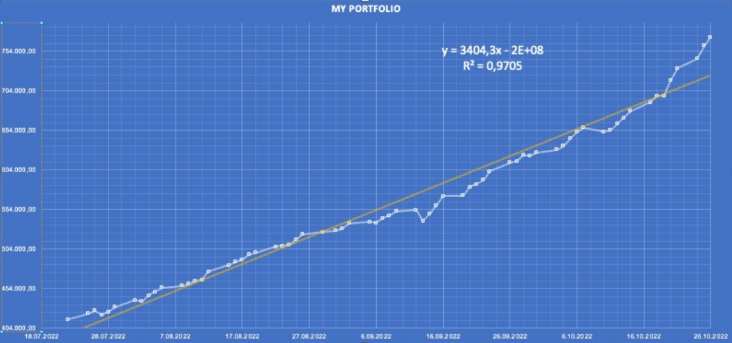
Performances of BIST Stock Exchange Portfolios
for similar time intervals
Single asset portfolio
5-asset Sharpe- optimized portfolio
17-asset MDD- optimized portfolio
Period Returns = %23.4
Stability = %2.53
Sharpe = 1.23
MDD = %20.4
Calmar R = 3.18
Period Returns = %364
Stability = %85
Sharpe = 3.61
MDD = 16.5 %
Calmar R = 16.97
Period Returns = % 87.6
Stability = %98.7
Sharpe = 16.5
MDD = 2.56 %
Calmar R = 17.8

Slide 7
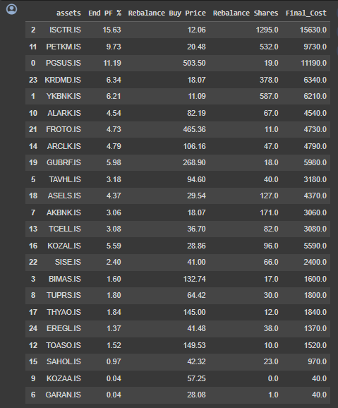
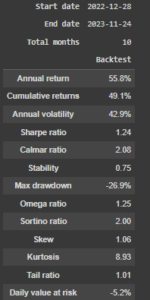
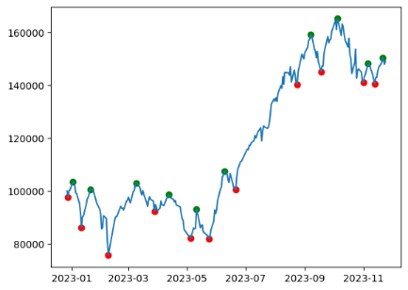
An optimized portfolio for 28.12.2022 – 24.12.2023

Slide 8
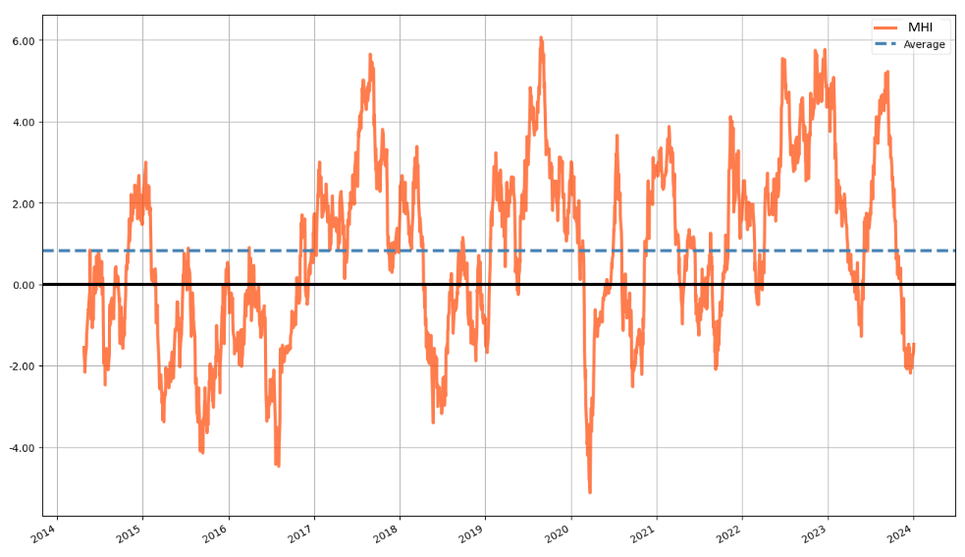
Market Health Index (MHI) for BIST30 - A mean-reverting index for trend detection

Slide 9
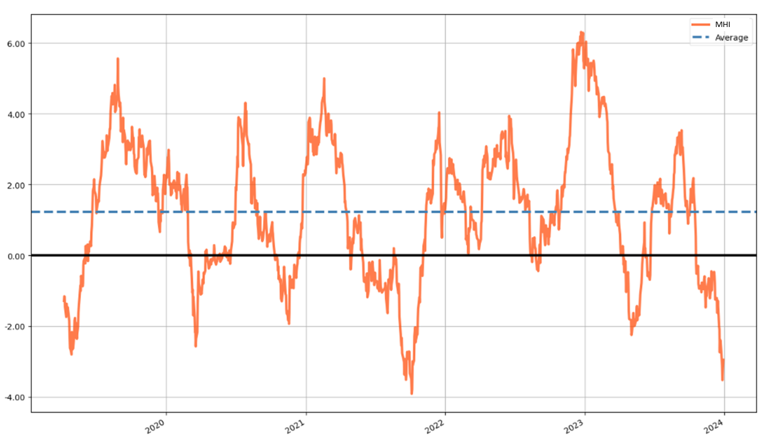
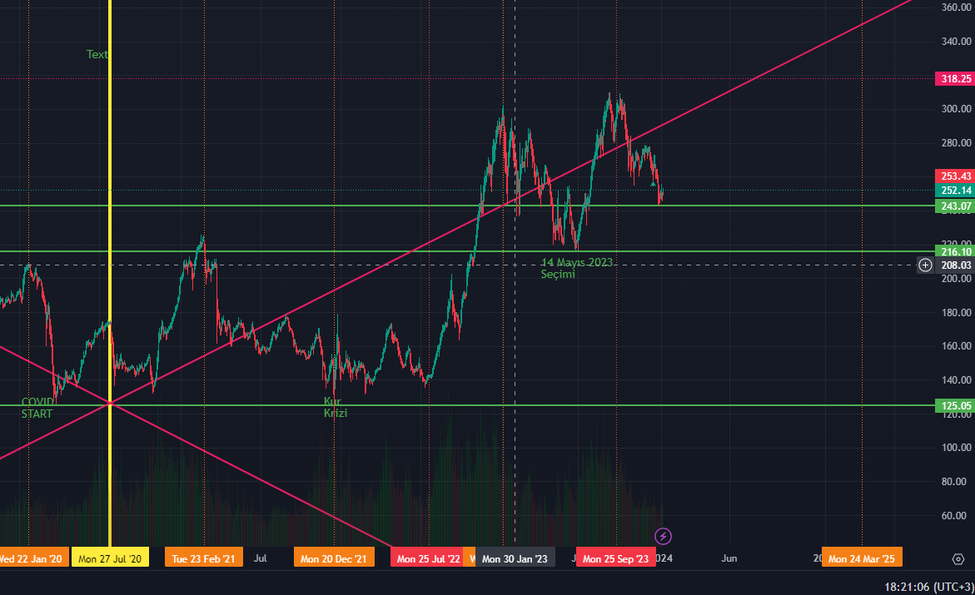
Market Health Index (MHI) - A mean-reverting index for trend detection
MHI on BIST30
Downtrend Uptrend
PREV UPTREND
23.08.2021 – 21.09.2022 21.09.2021 – 16.12.2021 (I)
16.12.2021 – 24.02.2022 24.02.2022 – 07.06.2022 (II)
07.06.2022 – 16.08.2022 16.08.2022 – 27.12.2022 (III)
27.12.2022 – 09.05.2023 09.05.2023 – 11.09.2023 (IV)
11.09.2023 – 26.11.2023 NEXT UPTREND
BIST100 – last 5 years
I-II-III-IV
Last 5 years >>

Slide 10
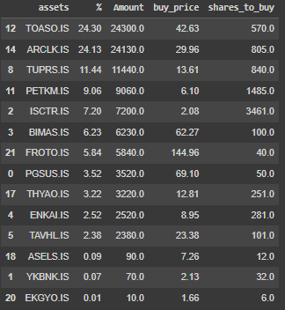
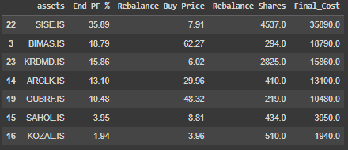
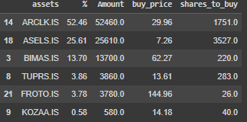
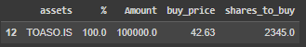
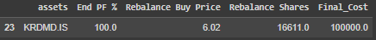
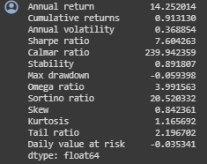
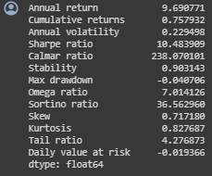
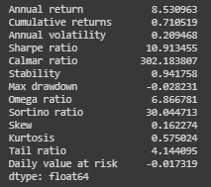
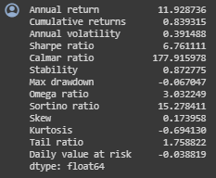
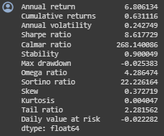
MHI portfolios for 21.09.2021 – 16.12.2021 (I)
Sharpe i-Sharpe MDD i-MDD MinVAR
Return: %91.3
SR: 7.6
MDD: %5.93
Calmar R: 240
Return: %75.8
SR: 10.48
MDD: %4
Calmar R: 238
Return: %71.1
SR: 10.91
MDD: %2.82
Calmar R: 302
Return: %83.9
SR: 6.76
MDD: %6.7
Calmar R: 178
Return: %63.1
SR: 8.61
MDD: %2.53
Calmar R: 268

Slide 11
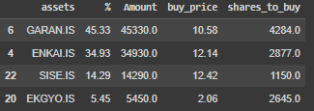
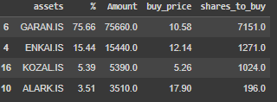
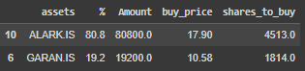
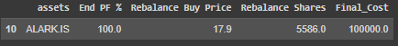
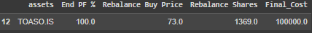
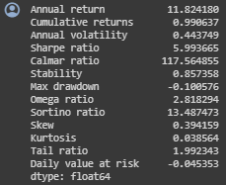
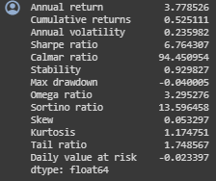
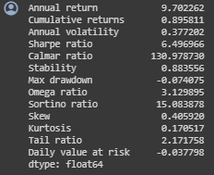
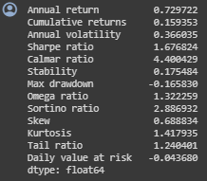
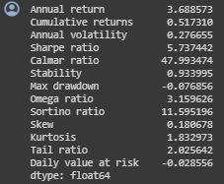
MHI portfolios for 24.02.2022 – 07.06.2022 (II)
Sharpe i-Sharpe MDD i-MDD MinVAR
Return: %99
SR: 5.99
MDD: %10.0
Calmar R: 117.6
Return: %52.5
SR: 6.76
MDD: %4.0
Calmar R: 94.5
Return: %89.6
SR: 6.49
MDD: %7.40
Calmar R: 131
Return: %15.93
SR: 1.67
MDD: %16.58
Calmar R: 4.4
Return: %51.7
SR: 5.73
MDD: %7.68
Calmar R: 48

Slide 12
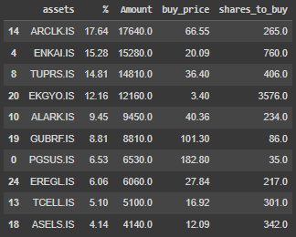
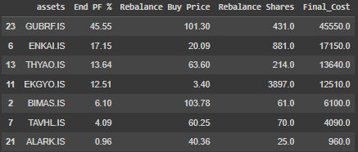
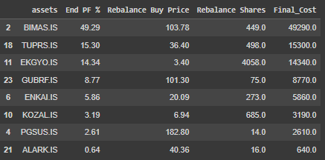
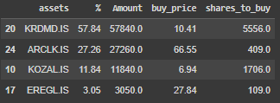
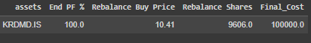
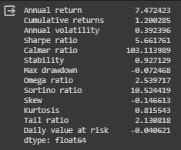
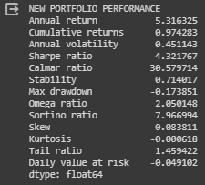
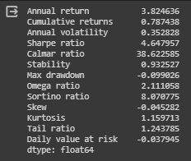
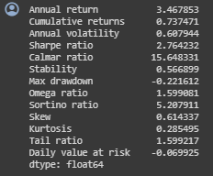
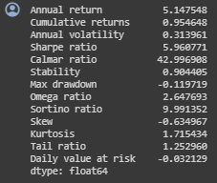
MHI portfolios for 16.08.2022 – 27.12.2022 (III)
Sharpe i-Sharpe MDD i-MDD MinVAR
Return: %120
SR: 5.66
MDD: %7.2
Calmar R: 103
Return: %97.4
SR: 4.32
MDD: %17.4
Calmar R: 30.5
Return: %78.7
SR: 4.64
MDD: %9.9
Calmar R: 38.6
Return: %73.7
SR: 2.76
MDD: %22.2
Calmar R: 15.6
Return: %95.5
SR: 5.96
MDD: %12.0
Calmar R: 43

Slide 13










MHI portfolios for 09.05.2023 – 11.09.2023 (IV)
Sharpe i-Sharpe MDD i-MDD MinVAR
Return: %56.6
SR: 2.75
MDD: %13.7
Calmar R: 21.2
Return: %80.4
SR: 3.96
MDD: %16.1
Calmar R: 31.1
Return: %92.3
SR: 4.82
MDD: %12.4
Calmar R: 50.7
Return: %65.6
SR: 3.39
MDD: %11.4
Calmar R: 31.8
Return: %64.3
SR: 3.96
MDD: %17.8
Calmar R: 19.8

Slide 14




Slide 15
Procedure for Portfolio Construction
Calculate and plot 5 year-MHI for at least 2 exchanges
Detect peaks (MHI > 4) and valleys (MHI < -2)
Apply Volatility and Correlation filters
At MHI < -2, start from latest peak, calculate best performing portfolio in downtrend, enter portfolio
At the first MHI > 4 , sell the portfolio and diverse to other exchange’s MHI < -2.

Slide 16

Filter for Correlation

Slide 17

Filter for Volatility

Slide 18

Our B2B Product:
AI assisted portfolios management with:
Entries-exits based on MHI of that exchange
Sharpe, i-Sharpe, MDD, i-MDD, MinVAR optimized
Correlation, volatility, fundamentals filtering
Multi-Exchange Consolidated returns
KAP news filter
Customer Positioning:
Investors with at least 16 month patience
Insurance, retiree funds
Retirees
MDD-optimized Multi-Exchange Portfolios with MHI alert

Slide 19






Slide 20


In 2024:
Notes:
Mühendislik olarak Front End yazılım uygulamasına ihtiyaç var: Robo Advisor
Yazılım güvenliği – Fikri hakların nasıl dağılacağını yönetmek
Yazılım SPL lisanslı olması gerek – Fon şirketi başvurabilir
Yazılım şirketi kuralım – Delaware C corp olsun – yatırımcı bulalım

Slide 21
Kerem: «benden ne istiyorsun» diye sorunca ☺ anlatılacak :
Ürün Vizyonu:
- Retail Customer lara Netflix gibi bir sayfa açılsın, film yerine portföy veya algoritma beğensin.
- Yazılım şirketi kuralım – TR ? Delaware C Corp ?
- B2B olarak Portföy Yönetim şirketlerine AI Algo/Portföy Hesaplama danışmanlığı
Ortaklık/Yönetim:
Mühendislik olarak web Front End App geliştirilmesi Backend ile entegrasyon
Yazılım güvenliğinin sağlanması –
Birden fazla yazılımcı ile Fikri haklar anlaşmaları
Fon şirketi başvurabildiği Sermaye Piyasası Lisansı alınması
Diğer ilgililer: Murat Özbayoğlu (TOBB-ETÜ), Vijay Singh Dalal (H-TECH), İlker Altıntaş (Akbank CIO)

